Slide 1
ISSUES OF RADICALIZATION AND EXTREME BEHAVIOURS IN PAKISTAN

Slide 2
AIM
To brief you on the dynamics leading to Radicalization and Extremism in Pakistan

Slide 3
SCOPE
Understanding Radicalization
Radicalization and Pakistan
Core Causes Leading to Radicalization
Proposed Counter-Radicalization Measures
Conclusion

Slide 4
UNDERSTANDING RADICALIZATION
Radicalization is defined as a change in belief, feeling, or behaviour towards increased support for intergroup conflict. It is a characteristic that challenges the fundamental nature of the existing social system, thus advocating political/social reforms

Slide 5
UNDERSTANDING RADICALIZATION
In the opinion of Ahmer Bilal Sufi, “radicalization is a mindset, which may be called religious aggression or violation of religion. In his opinion, when someone deviates from law, he behaves as a radical”
Radicalization and Talibanization
Is every Radical a Terrorist?

Slide 6
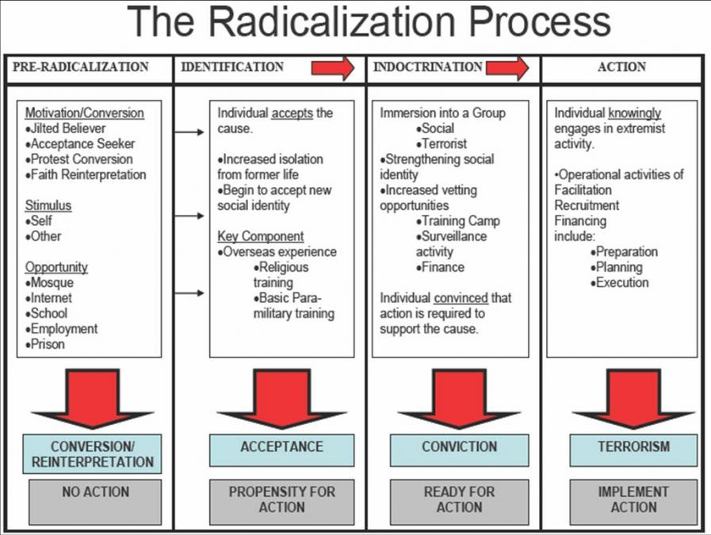

Slide 7
RADICALIZATION AND PAKISTAN
Core Causes Leading to Radicalization
Global Perspective
Afghan Jihad
Madrassa Culture
Sectarian Outfits
Afghan Refugees
US Led WoT – Anti-Islam Policies

Slide 8
RADICALIZATION AND PAKISTAN
Causes Specific to Pakistan
“You are free; you are free to go to your temples, you are free to go to your mosques or to any other place or worship in this State of Pakistan. You may belong to any religion or caste or creed that has nothing to do with the business of the State ... We are starting with this fundamental principle that we are all citizens and equal citizens of one State”

Slide 9
RADICALIZATION AND PAKISTAN
“The principles of democracy, freedom, equality, tolerance and social justice, as enunciated by Islam, shall be fully observed”
(Objective Resolution – 1950)

Slide 10
RADICALIZATION AND PAKISTAN
Political Culture
Pakistan’s political culture believes in “buy, cheat or muscle your way into public office and them simply relax”
Politically Motivated Interpretation of Islam

Slide 11
RADICALIZATION AND PAKISTAN
Religious Disharmony
“How does the world judge our claim? It looks upon us as terrorists. We have been killing each other. ... Our claim of tolerance is phony. ---What about mutual tolerance? It exists nowhere. Instead, we are killing each other wearing masks….My particular appeal to all those Ulema who are sitting here to promote harmony. Why can’t we maintain this harmony outside? Why should we weaken ourselves internally?”

Slide 12
RADICALIZATION AND PAKISTAN
Judicial System
Culture of Corruption
Class Divide
Economic Deprivation
Education System
Hasan Askari Rizvi has provided a clear picture as to how State policies affect society as a whole. He says that when the State education system is unable to offer a balanced education with an emphasis on political, cultural, and religious pluralism, a large number of young people become vulnerable to narrow and extremist appeals. Some of them may cross over to the phenomenon of terrorism as a strategy for advancing their causes

Slide 13
RADICALIZATION AND PAKISTAN
Unemployment
Social Anxiety
Lack of Recreational Activities
Our Pakistani concept of a human being is wrong; we do not realize that cultural activities are as important for a human being as other aspects of human life
Negative Projection by Media

Slide 14
COUNTER RADICALIZATION MEASURES
De-Radicalization and Rehabilitation
Religious Harmony
Development Work in FATA
Control Over Radical Literature
Extremist Funding
Role of Media

Slide 15
CONCLUSION
Causes of radicalization in Pakistan could be identified as government policies, political expediencies and international actors. Socio-cultural factors revolve around our culture of education, which is extremely skewed; religious culture, which is polarized and sectarian; and economic culture, which is widely unequal. Authoritarian and undemocratic attitudes and institutions are also among the factors. Religion, media and education have been used as tools of radicalization by the state and the non-state actors

